Slide 1
Business, Marketing, Entrepreneurship, Digital Marketing, and Econ Mrs. Schafer

Slide 2
The Power of Open-ended Questions
Paired Interviewing
Elevator Pitches

Slide 3
Asking/Answering Questions
Q1: What kind of question gets the most information out of a person?
Yes or no?
Open-ended?
Q2: For what aspects of business will you need to be adept at ASKING open-ended questions?
Notes:
Asking: conducting product research—finding out what people think of your ideas; interviewing others

Slide 4

In-Class Activity – Paired Interviewing
Choose 3 of the below (or create your own, respectful questions) to ask your assigned classmate. Write down responses/take notes. Be prepared to talk about the answers for your person in the next class.
Interview questions:
What do you see yourself doing as a profession 10 years from now?
Do you have any influences/influencers in life that make you want to do that profession?
What’s the coolest product you’ve ever tried? Why do you think it’s the best?
What do you think is your greatest strength/ability?
Fav movie and why?
Fav food and why?

Slide 5
Elevator Pitches
What is an elevator pitch?
In what instances would you use one in the future?
Notes:
Anywhere you have to explain something succinctly in 30 seconds or less
Importance of summarization
Interview
Top of Resume
Product pitch
Explaining your product to investors
Explaining your product to consumers
Product label

Slide 6

Resume & My Elevator Pitch
Elevator: 21 years of experience working on strategic projects for start-ups to Fortune 500 companies in industries from technology to government, owner of an LLC in the pet products area and author of 4 published fiction novels.
Undergrad degree in business: marketing and PR. MBA in entrepreneurship
Worked in Marketing for Black & Decker/DeWalt
Worked for 14 yrs consulting intelligence agencies in the federal gov with a topsecret security clearance
Moved to Seattle and switched to commercial consulting for MSFT, Amazon, and Nordstrom
Owner of a cat accessory company
Author of 4 published Young Adult Fiction Sci-fi books
Married with 2 kids, 2 dogs, 2 cats
Lots of ties back to NJ, NY, DC, and Maryland
Love pumpkin picking

Slide 7
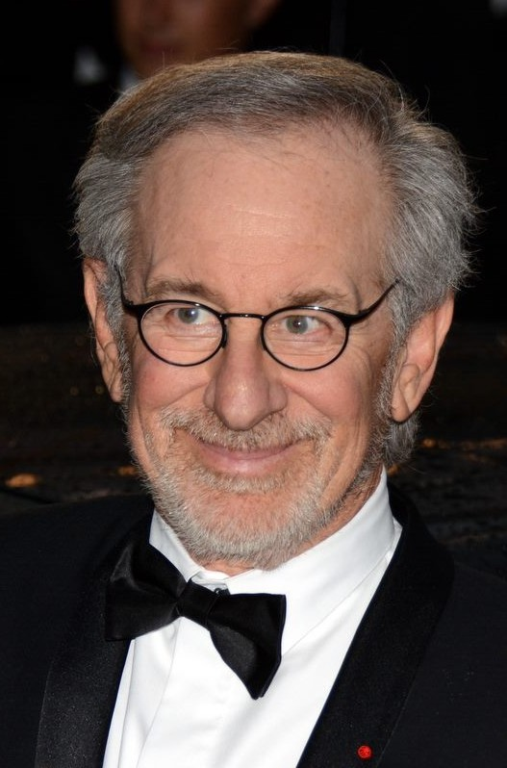

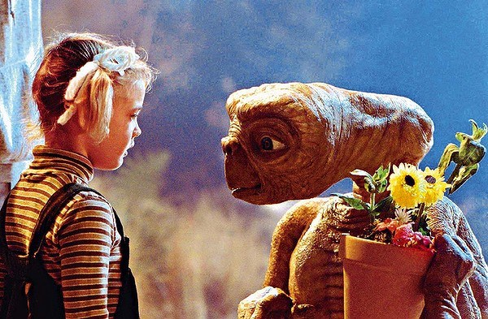
Homework Assignment
Steven Spielberg is going to make a movie about someone’s life and is currently deciding.
YOU happen to be in an empty elevator when the doors slide open, and Spielberg walks in!
Elevator Pitch about yourself: 30 seconds to tell Steven Spielberg the most interesting things about you and convince him to make his movie about you.
Prepare to tell everyone out loud that 30 second elevator pitch when we next meet. What makes you unique? What do you want people to know about you?

